Slide 1

SEVEN MODULES, ONE PLATFORM
Footfall & conversion
AI VIDEO ANALYTICS · PROPOSAL & LIVE DEMO
More value from the
cameras you already own
Billing-queue alerts
Shelf dwell heatmaps
Machine uptime
One AI layer across both sides of SBC's business — retail bookstores and the printing & paper-converting plant.
PPE compliance
Fire & smoke detection
Prepared for SBC Store (retail + printing division)
Print-defect detection
Trinetra Systems · Bengaluru

Slide 2

THE OPPORTUNITY
Two very different problems, one camera network
SBC already runs CCTV in the stores and on the shop floor. Today it is used to look back. AI turns it into a system that acts in real time.
RETAIL BOOKSTORES
PRINTING & PAPER CONVERTING
You can count sales. You cannot count the sales you missed.
Downtime, defects and safety lapses are found after the fact.
How many people walked in but never billed?
Which aisles hold attention — and which are dead space?
How long did the billing queue run before anyone noticed?
When exactly are the peak hours, store by store?
Which press sat idle, for how long, and on whose shift?
A defective run is caught at the end — thousands of sheets late.
PPE is checked by supervision, not by record.
Paper, ink and solvent make fire a first-minute problem.
Same hardware. Same cameras. Seven answers that arrive while you can still do something about them.
Trinetra Systems · AI Video Analytics for SBC Store
2

Slide 3
WHAT WE DEPLOY
Seven analytics modules across the group
Each module runs on your existing IP cameras and reports into one dashboard.
01
02
03
04
Footfall & conversion
Billing-queue alerts
Shelf dwell heatmaps
Machine uptime & idle
People in vs. people billed, hour by hour
Live queue length with open-a-counter alerts
Where customers stop, aisle by aisle
Running vs. idle time per press, per shift
05
06
07
PPE compliance
Fire & smoke detection
Print & paper defects
Helmet, vest and goggles checks on the floor
Visual detection in seconds, push to mobile
Streaks, spots and smudges caught on the web
Trinetra Systems · AI Video Analytics for SBC Store
3

Slide 4
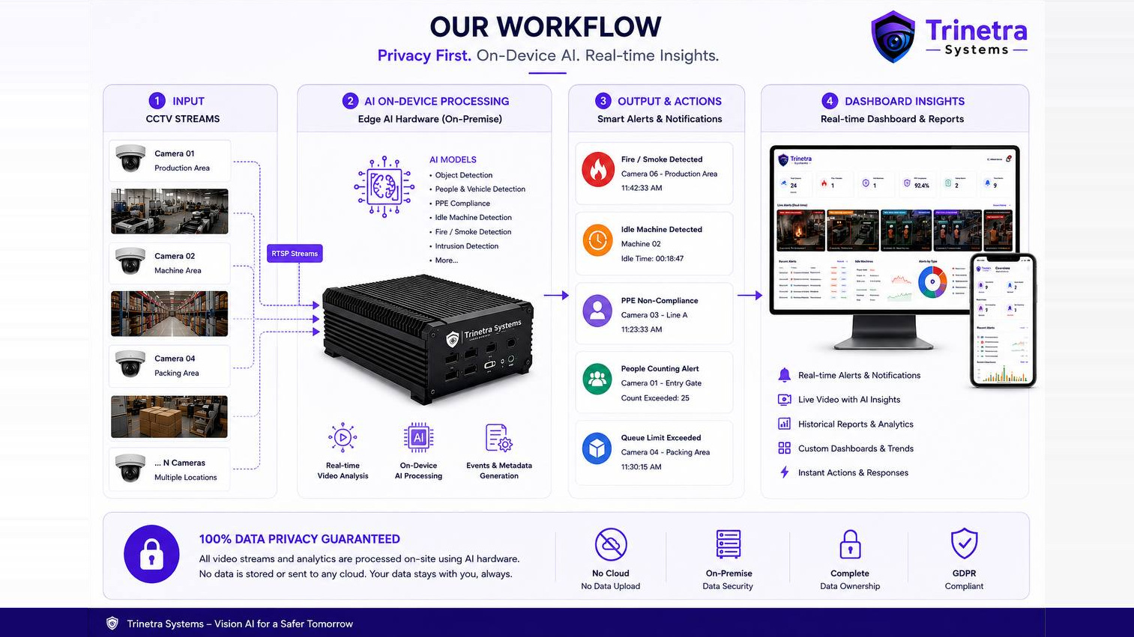

Slide 5
01
PART ONE
Retail store intelligence
Footfall & conversion · billing-queue alerts · shelf dwell heatmaps
Trinetra Systems · AI Video Analytics for SBC Store
5

Slide 6
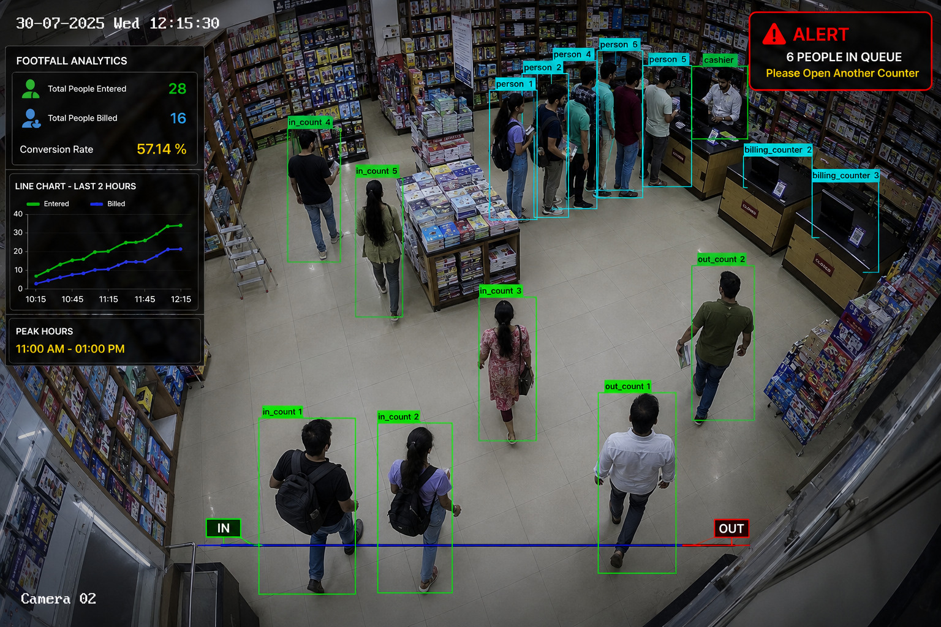
MODULE 01 · RETAIL
Footfall and conversion, counted automatically
A single entry camera turns walk-ins into a number you can manage.
WHAT THE SYSTEM SEES
Every person crossing the IN and OUT line, counted separately
Billing events matched against entries in the same window
Entered vs. billed plotted through the day
WHY IT MATTERS
Judge promotions and displays on traffic, not guesswork
Roster staff against the real peak, not the assumed one
Representative visualisation of Trinetra's detection output.
28 / 16
57.14%
11 AM – 1 PM
Entered vs. billed in the window
Conversion rate, computed live
Detected peak-hour band
Trinetra Systems · AI Video Analytics for SBC Store
6

Slide 7
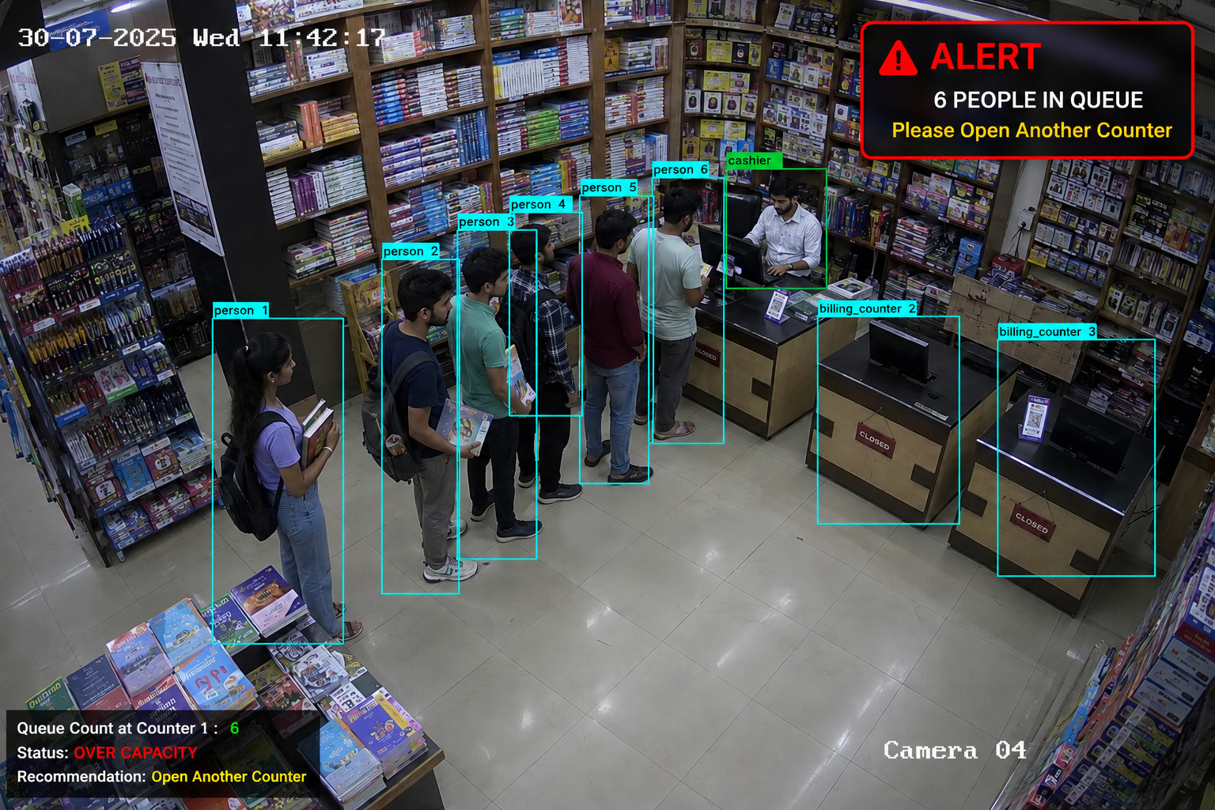
MODULE 02 · RETAIL
Nobody leaves because the queue got long
The system watches the billing counters and raises an alert before customers abandon the line.
WHAT THE SYSTEM SEES
Queue length at each counter, updated continuously
Which counters are open and which are closed
How long the queue has been over its threshold
WHY IT MATTERS
A second counter opens on evidence, not on a complaint
Queue history exposes the hours that need a floater
Representative visualisation of Trinetra's detection output.
ALERT · 6 people in queue
Alerts reach the store manager's phone and the counter display at the same moment.
Status: over capacity → open another counter
Trinetra Systems · AI Video Analytics for SBC Store
7

Slide 8
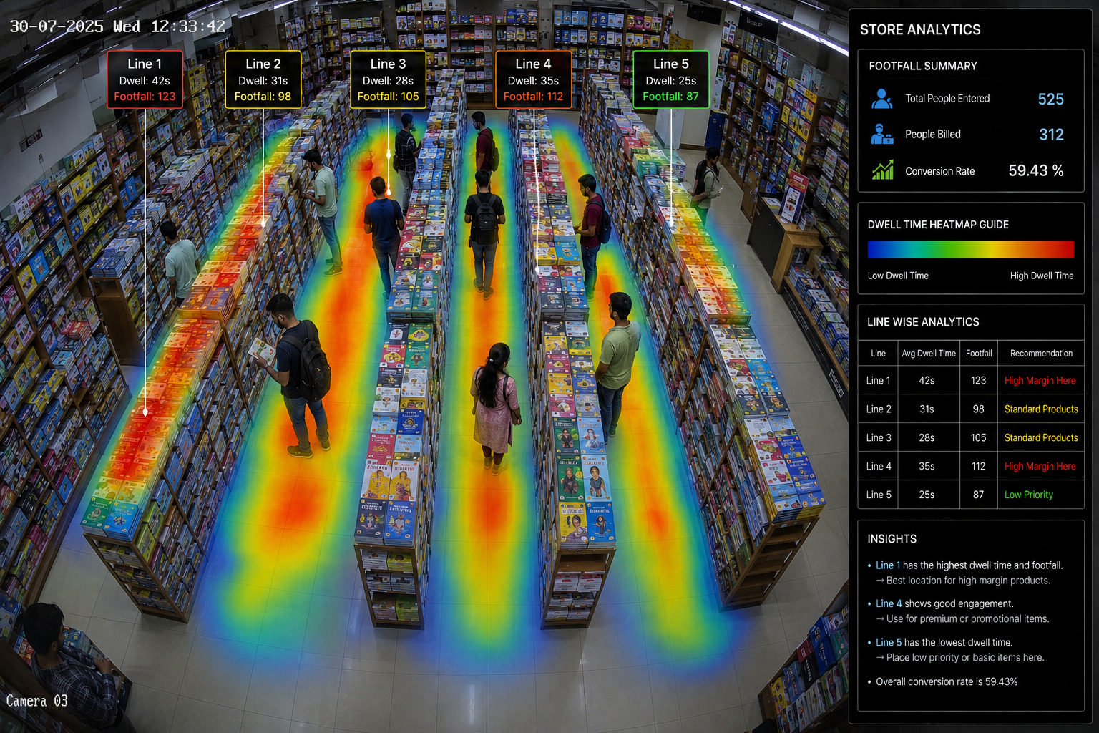
MODULE 03 · RETAIL
Which aisle earns its shelf space
Dwell-time heatmaps show where attention actually goes — the input every merchandising decision needs.
WHAT THE SYSTEM SEES
Average dwell time and footfall for every aisle
Heat overlay of standing time across the floor
Ranking of aisles from strongest to weakest
WHY IT MATTERS
Put high-margin and new titles where people already stop
Move slow stock off prime shelf and re-test next month
Representative visualisation of Trinetra's detection output.
42s
25s
59.43%
Top dwell — Line 1, best margin slot
Lowest dwell — Line 5, low priority
Store conversion for the period
Trinetra Systems · AI Video Analytics for SBC Store
8

Slide 9
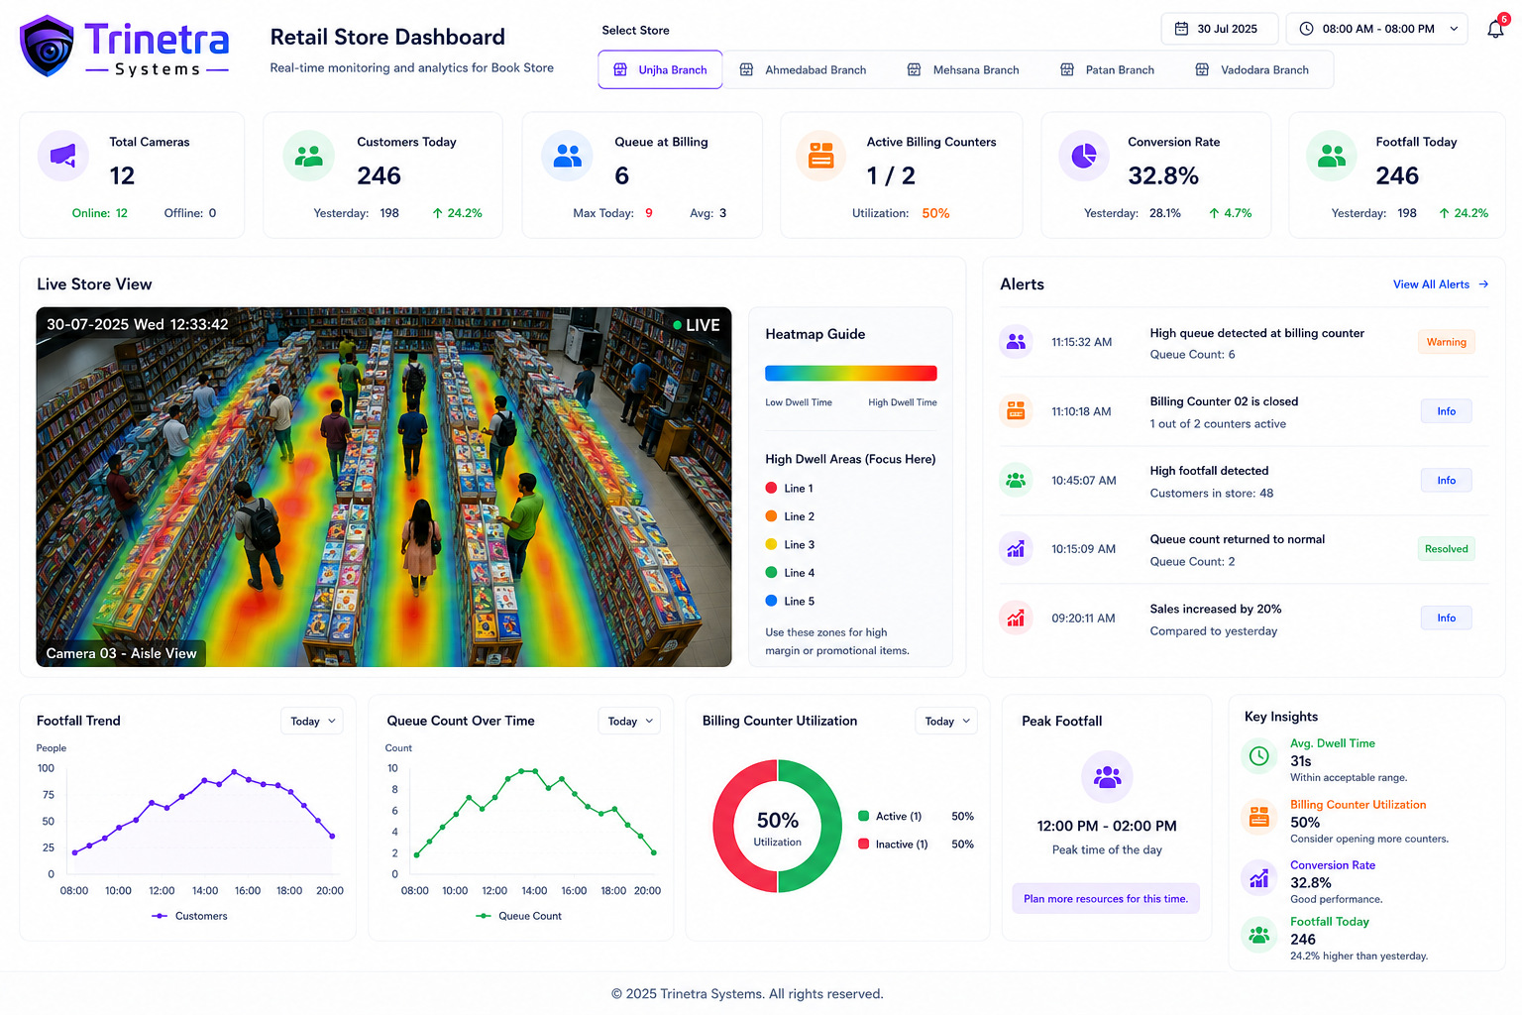
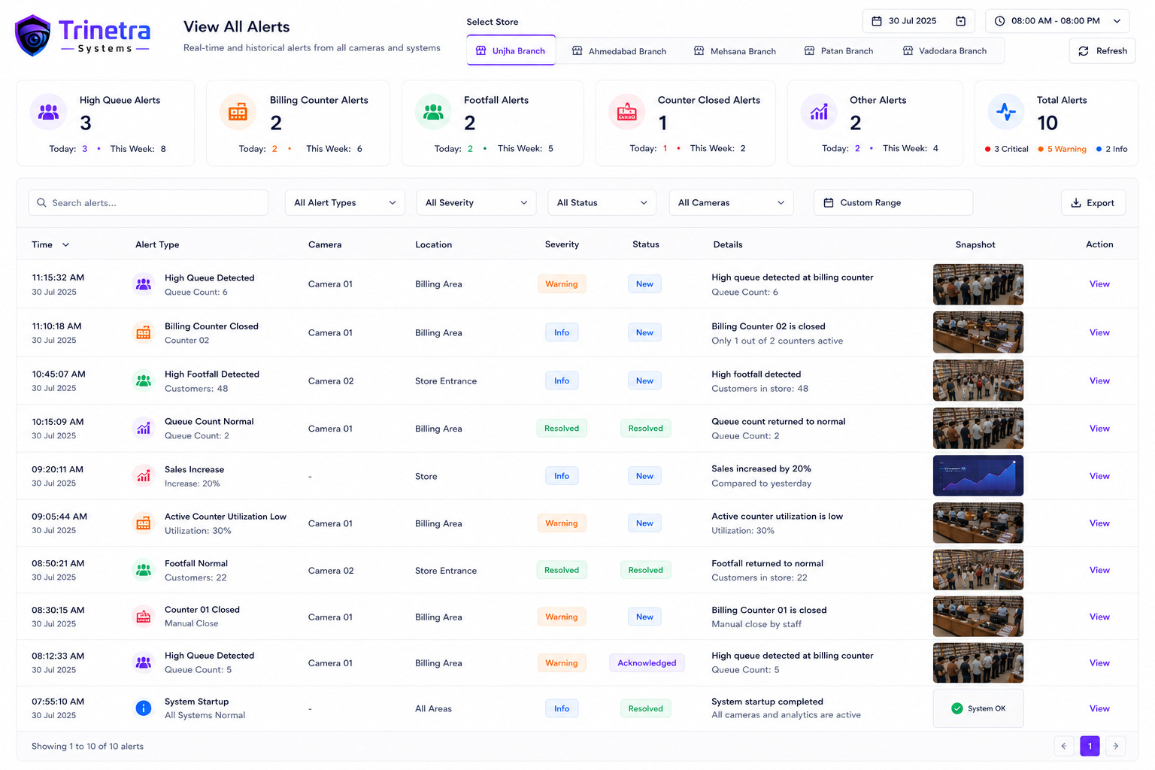
THE DASHBOARD · RETAIL
Every branch on one screen
Store staff see today. Head office sees every branch on the same metrics, side by side.
Full alert log — searchable, filterable, exportable.
ON THE SCREEN
Branch selector for every store
Live view, footfall and queue charts
Alerts with severity and snapshot
Retail dashboard — live store view, footfall trend, queue and counter utilisation.
Trinetra Systems · AI Video Analytics for SBC Store
9

Slide 10
02
PART TWO
Printing & paper converting
Machine uptime · PPE compliance · fire & smoke · print-defect detection
Trinetra Systems · AI Video Analytics for SBC Store
10

Slide 11
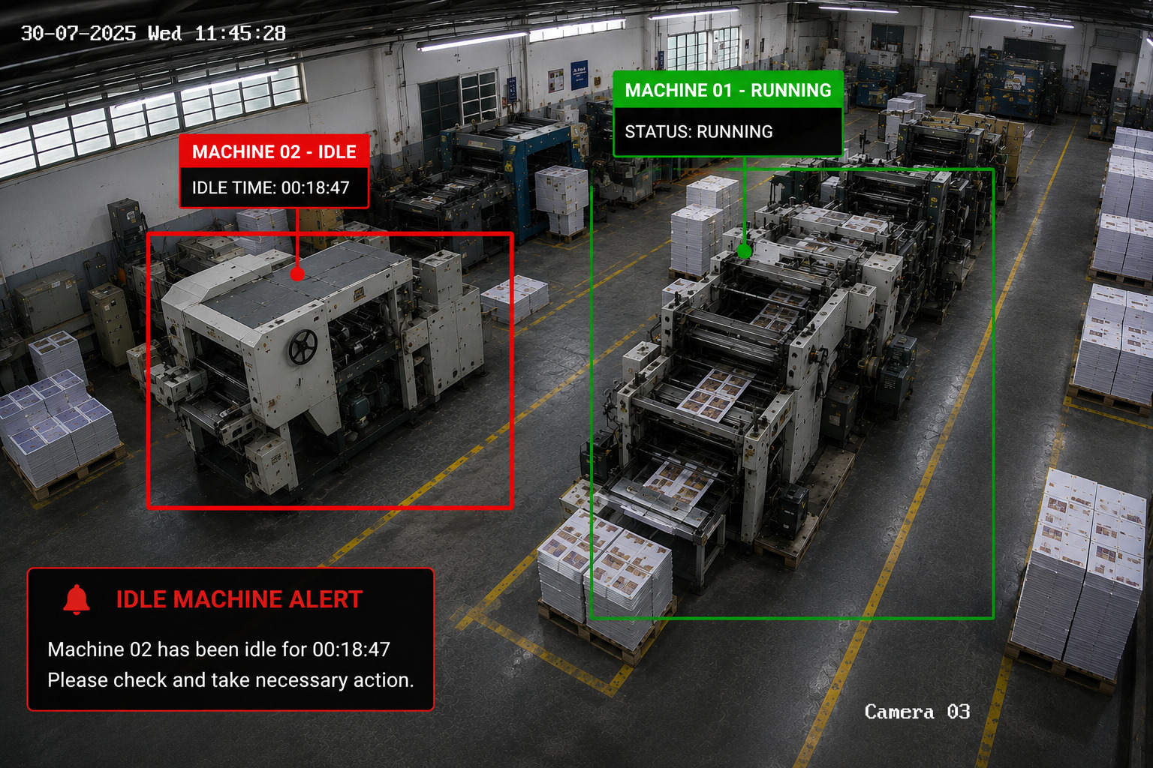
MODULE 04 · PLANT
Idle presses, timed to the second
The camera reads whether a machine is actually producing — and starts a clock the moment it stops.
WHAT THE SYSTEM SEES
Running or idle status for every machine in frame
Continuous idle duration, machine by machine
Alert once idle time crosses your threshold
WHY IT MATTERS
Shift-wise utilisation report without a manual log
Separates changeover, breakdown and unexplained idling
Representative visualisation of Trinetra's detection output.
MACHINE 02 · IDLE 00:18:47
Eighteen minutes of idle time, three times a shift, is a full production hour lost every day.
Supervisor notified automatically
Trinetra Systems · AI Video Analytics for SBC Store
11

Slide 12
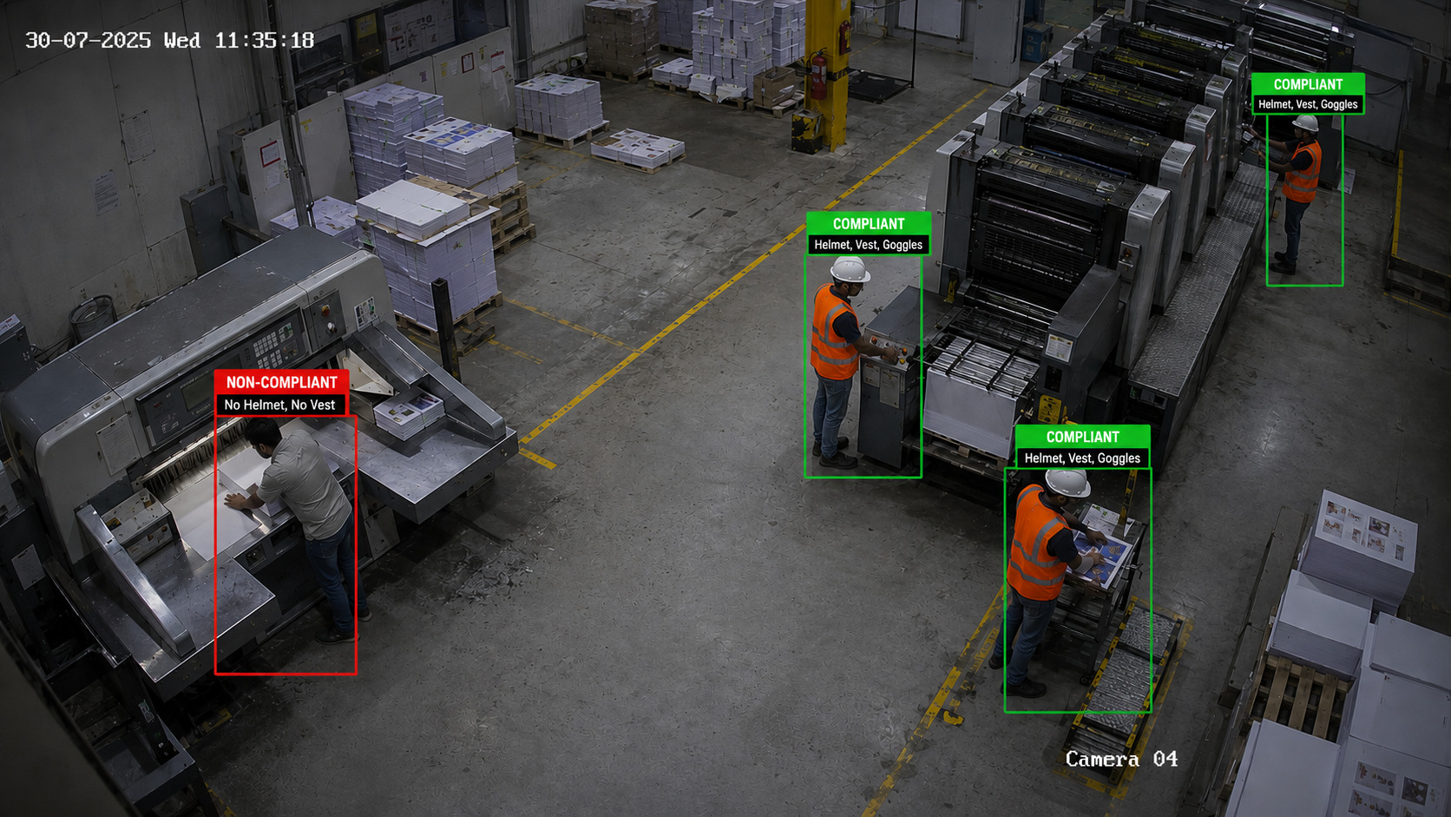
MODULE 05 · PLANT
Safety compliance that keeps its own record
Every person on the floor is checked for helmet, vest and goggles — continuously, without a supervisor standing there.
WHAT THE SYSTEM SEES
Helmet, vest and goggles checked per person
Non-compliance flagged with a timestamped snapshot
Zone-wise rules — cutting area stricter than dispatch
WHY IT MATTERS
Audit evidence for buyers, insurers and inspections
Coaching by pattern instead of by confrontation
Representative visualisation of Trinetra's detection output.
3 of 4
1 flagged
24 × 7
Operators compliant in this frame
No helmet, no vest — cutting machine
Checked on every shift, night included
Trinetra Systems · AI Video Analytics for SBC Store
12

Slide 13
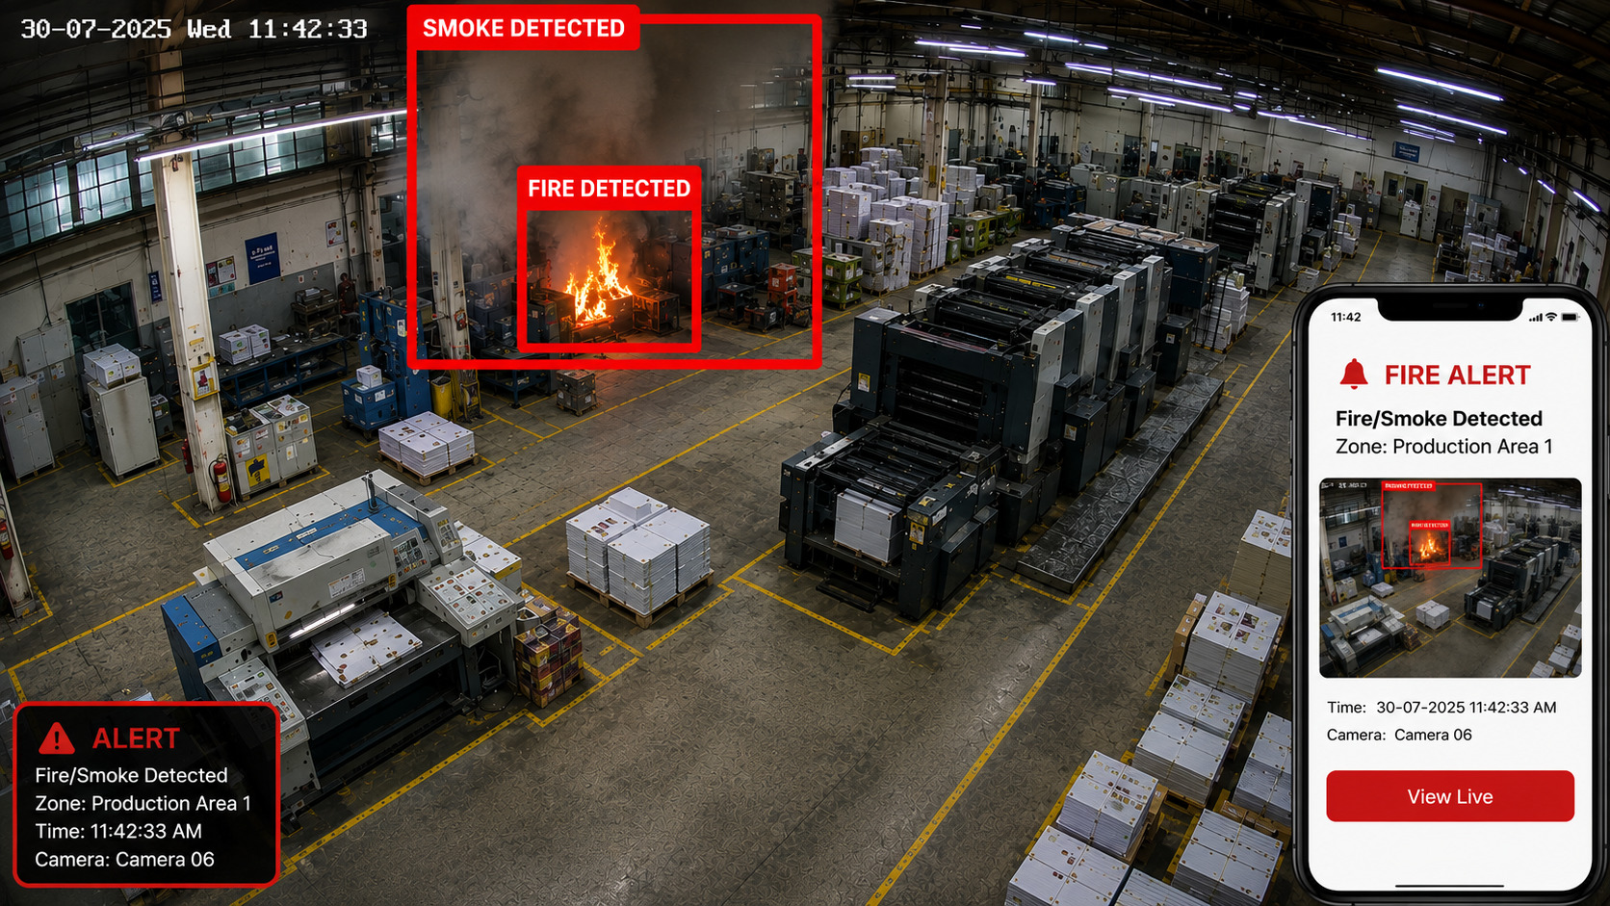
MODULE 06 · PLANT
Fire seen in seconds, not minutes
Paper, ink and solvent do not give you a second chance. Visual detection beats point sensors in a large open bay.
WHAT THE SYSTEM SEES
Flame and smoke detected as visual signatures
Zone, camera and timestamp attached to the event
Snapshot pushed to phones with a live-view link
WHY IT MATTERS
No waiting for smoke to reach a ceiling detector
Runs on the same cameras already covering the bay
Representative visualisation of Trinetra's detection output.
Detection to phone alert in under 5 seconds
Complements your existing fire system — it does not replace certified detection or suppression equipment.
Zone, camera and snapshot included
Trinetra Systems · AI Video Analytics for SBC Store
13

Slide 14
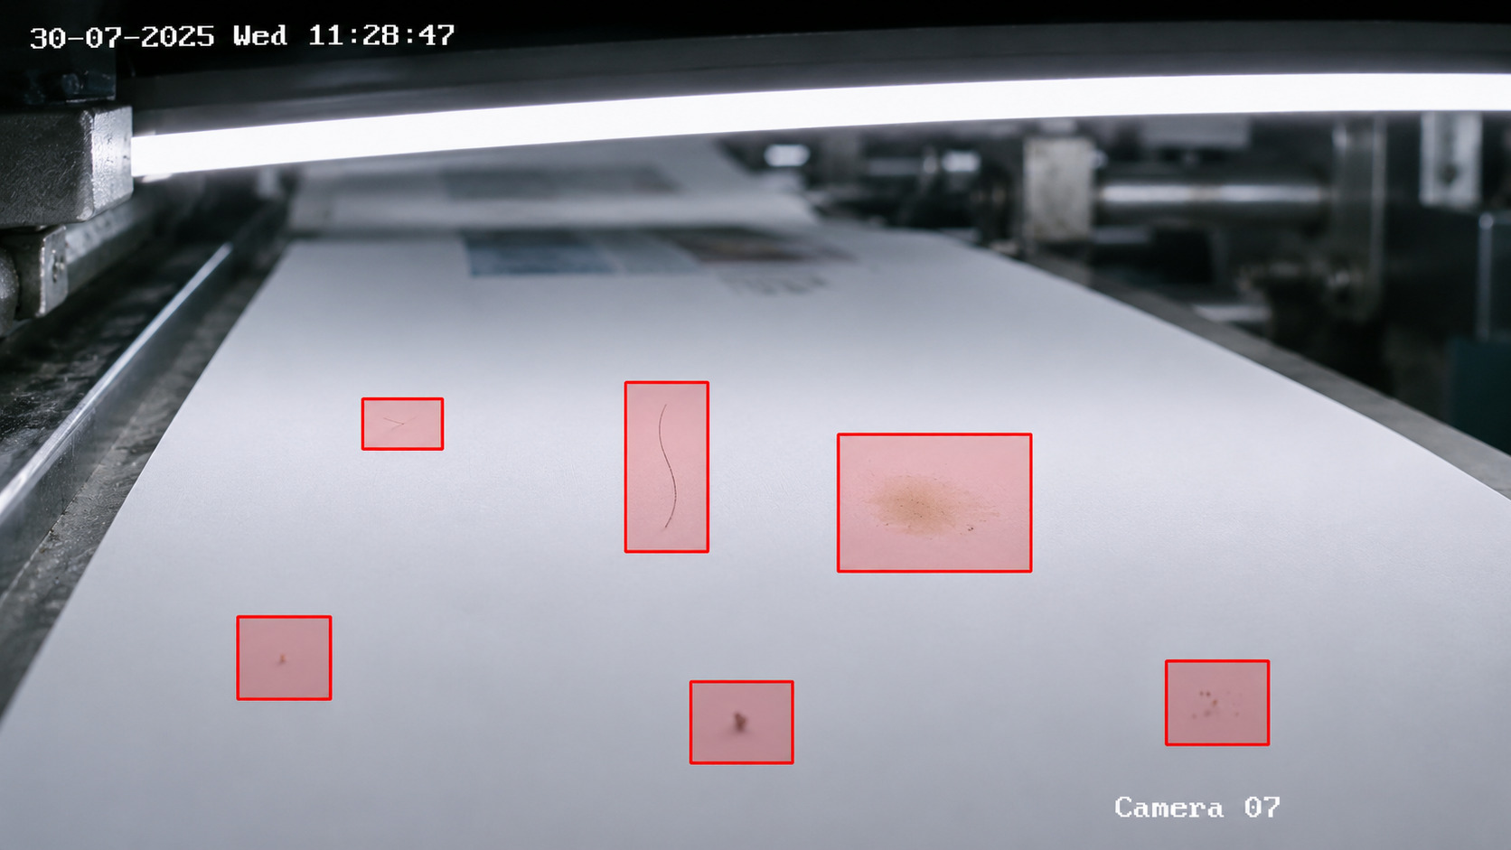
MODULE 07 · PLANT
Defects caught on the web, not in the bindery
A camera over the running sheet flags streaks, spots, hair and ink smudges while the run can still be stopped.
WHAT THE SYSTEM SEES
Ink spots, streaks, hairs, scratches and smudges
Defect position marked on the sheet
Repeat defects flagged as a roller or blanket fault
WHY IT MATTERS
Stop a bad run in minutes, not thousands of sheets later
Waste and rework reported per job, per machine
Representative visualisation of Trinetra's detection output.
6 defects
Per-job log
Root cause
Flagged in the single frame shown
Every defect stored with an image
Repeat position isolates the unit
Trinetra Systems · AI Video Analytics for SBC Store
14

Slide 15
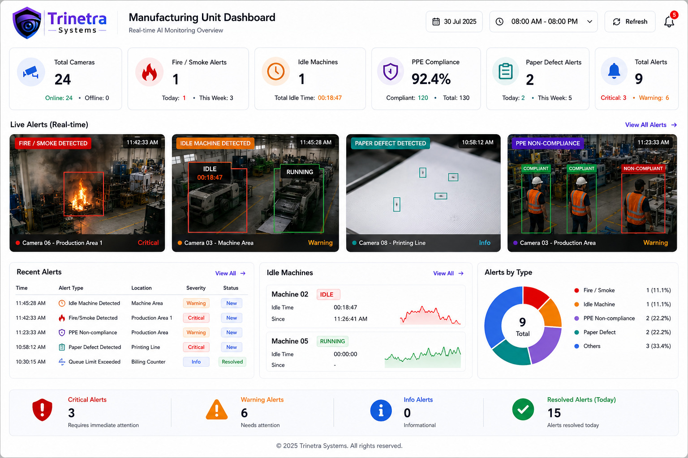
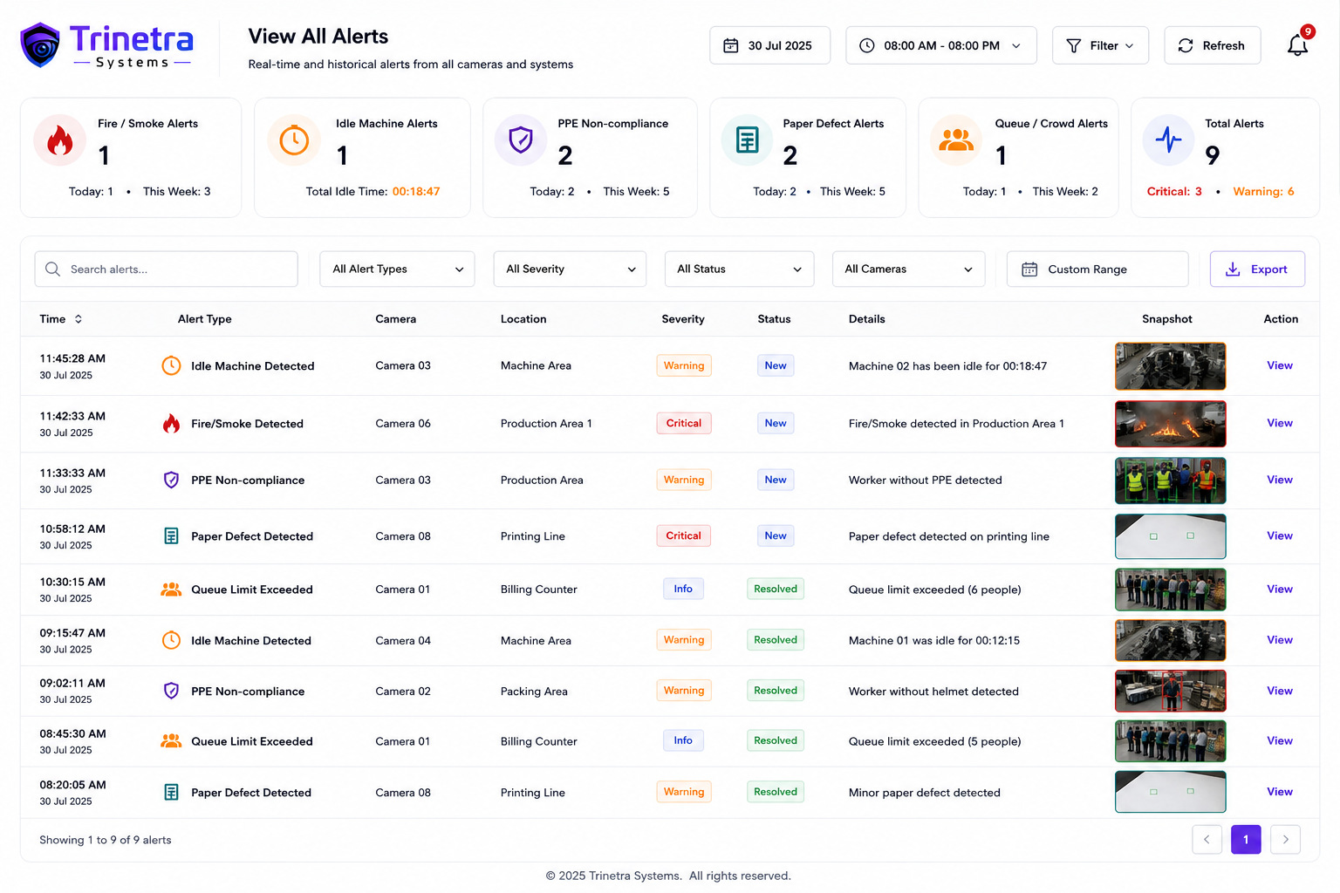
THE DASHBOARD · PLANT
The whole floor, in one view
Camera health, live alerts, idle machines and PPE compliance on a single screen.
Every event logged with time, camera, location and snapshot.
ON THE SCREEN
Camera health and PPE at a glance
Alert tiles with the trigger frame
Idle time logged per machine
Manufacturing dashboard — live alert tiles, idle-machine panel and alert breakdown by type.
Trinetra Systems · AI Video Analytics for SBC Store
15

Slide 16
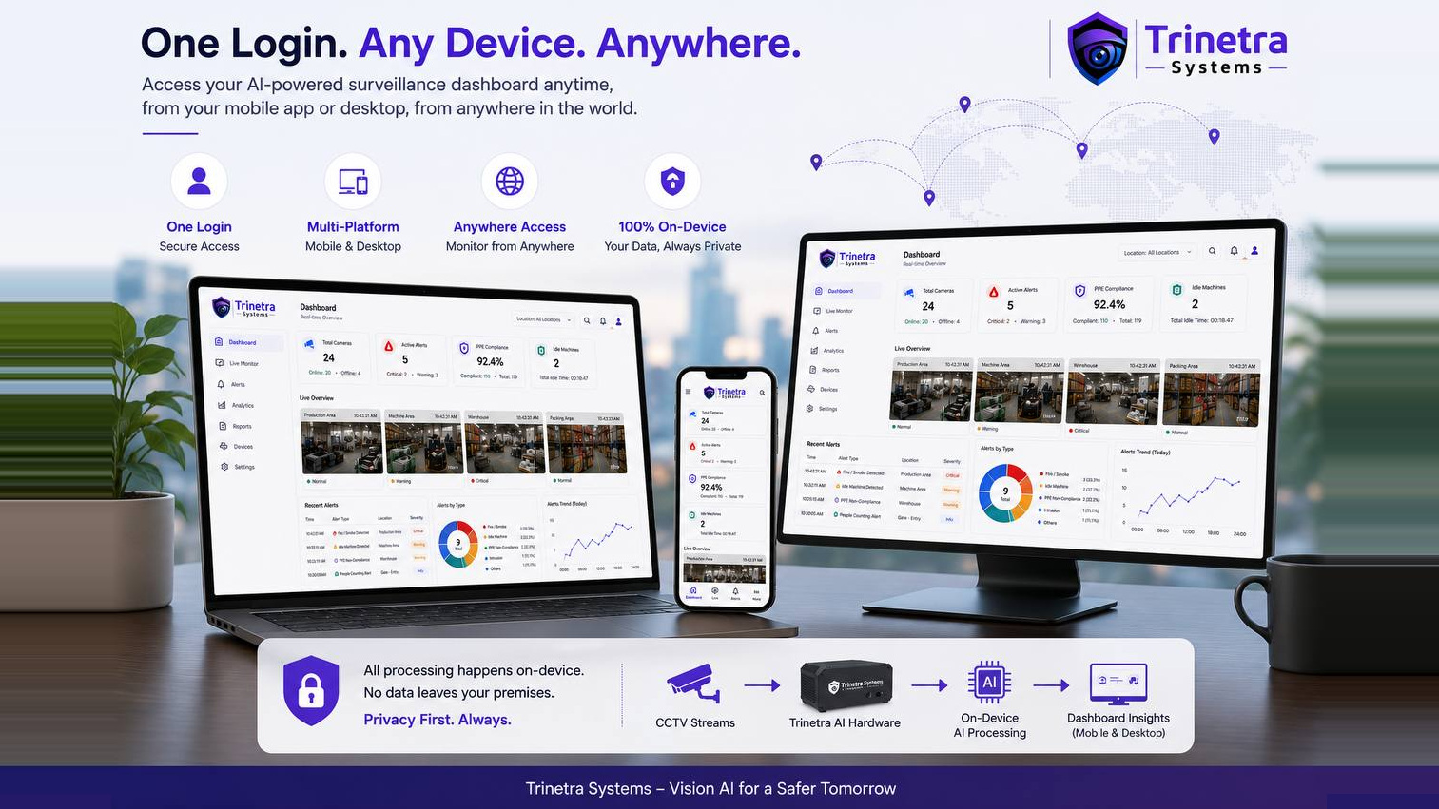

Slide 17
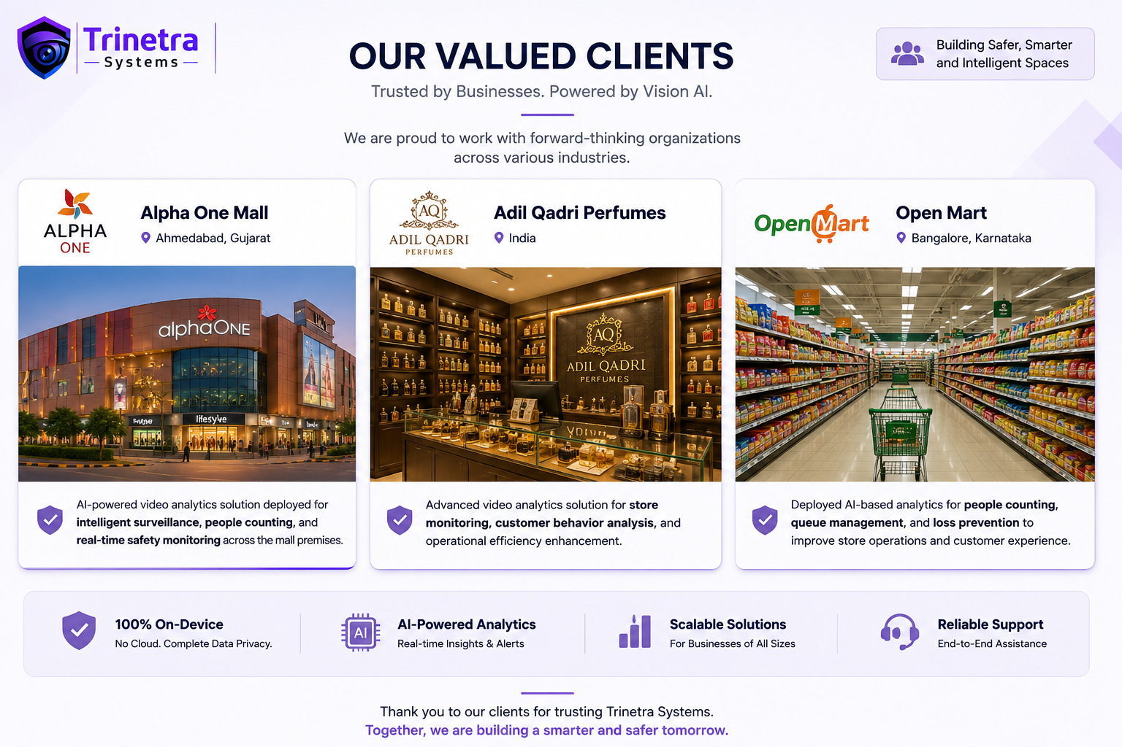
Trinetra Systems · AI Video Analytics for SBC Store
17

Slide 18
Thank you
Vision AI for a Safer Tomorrow
Let's walk your store and press hall, and start the pilot.
Trinetra Systems · Bengaluru

